Slide 1
Laravel Framework
(15 hours)
Notes:
Title - The learning outcome
Subtitle - Duration

Slide 2
In this section, we will discuss:
Views in Laravel with complete conditional and looping construct.
Controllers and its usage.
Complete database connectivity with DB
Complete Database connectivity with Eloquent Model and its working.
Notes:
Mention the parent topics one by one. This particular learning outcome has 4 parent topics.

Slide 3
Views
Creating Views
Views contain the HTML served by your application and separate your controller / application logic from your presentation logic.
Views are stored in the resources/views directory.
Image Source: https://www.tutorialspoint.com/internet_technologies/internet_overview.htm/
Notes:
Left (White Color space):
Title - Parent Topic
Subtitle - Subtopic 1
Body Text - Description in bullets
Right (Grey Color Space):
Body Text - Relevant image (with source)/code snippet
Put reference links in Speaker Notes
Reference:
https://www.tutorialspoint.com/internet_technologies/internet_overview.htm/

Slide 4
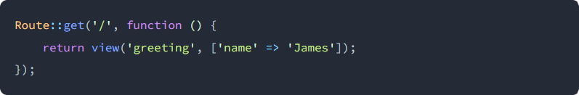
Views
Creating Views
A view can be called using the view helper function:
view(string $path, array $data = [])
Notes:
Left (White Color space):
Title - Parent Topic
Subtitle - Subtopic 1
Body Text - Description in bullets
Right (Grey Color Space):
Body Text - Relevant image (with source)/code snippet
Put reference links in Speaker Notes
Reference:
https://www.tutorialspoint.com/internet_technologies/internet_overview.htm/

Slide 5
Views
Passing Data To Views
Pass an array of data to views:
return view('greetings', ['name' => 'Victoria’]);
Passing a complete array of data to the view helper function
return view('greeting')->with('name', 'Victoria');
Image Source: https://www.tutorialspoint.com/internet_technologies/internet_overview.htm/
Notes:
Left (White Color space):
Title - Parent Topic
Subtitle - Subtopic 1
Body Text - Description in bullets
Right (Grey Color Space):
Body Text - Relevant image (with source)/code snippet
Put reference links in Speaker Notes
Reference:
https://www.tutorialspoint.com/internet_technologies/internet_overview.htm/

Slide 6
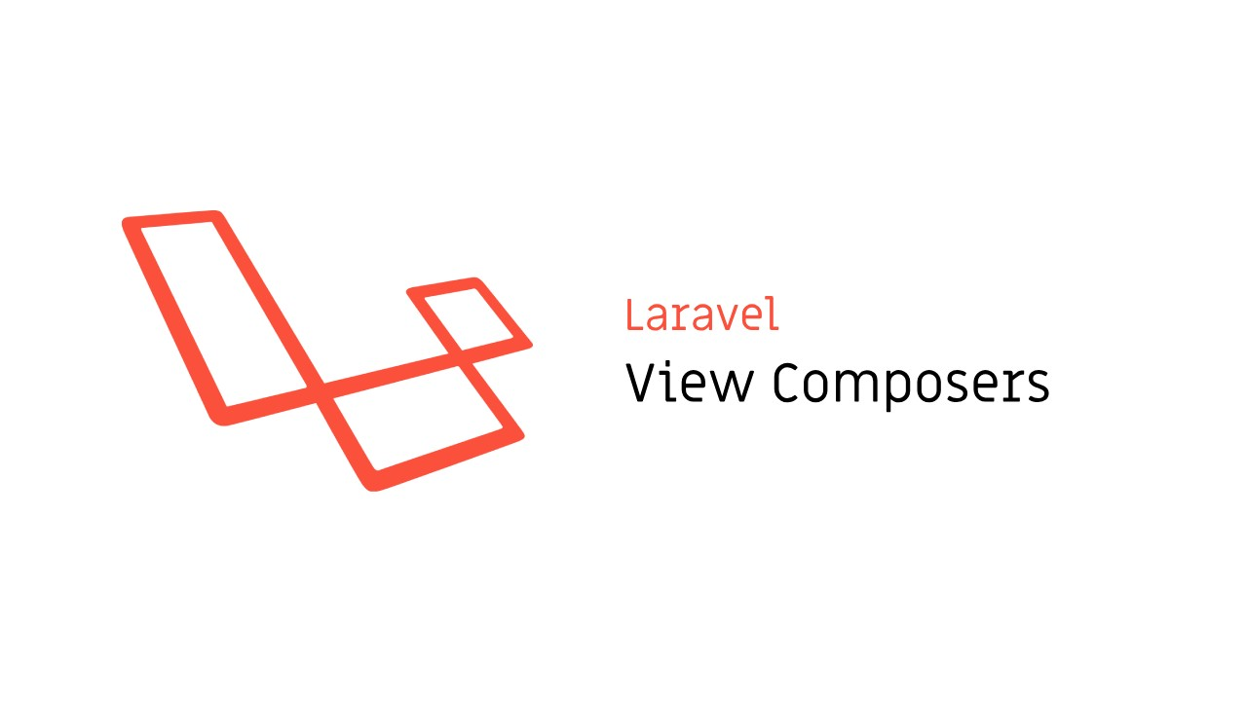
Views
View Composers
View composers are callbacks or class methods that are called when a view is rendered. pass an array of data to views:
Image Source:
Notes:
Left (White Color space):
Title - Parent Topic
Subtitle - Subtopic 1
Body Text - Description in bullets
Right (Grey Color Space):
Body Text - Relevant image (with source)/code snippet
Put reference links in Speaker Notes
Reference:
https://www.tutorialspoint.com/internet_technologies/internet_overview.htm/

Slide 7
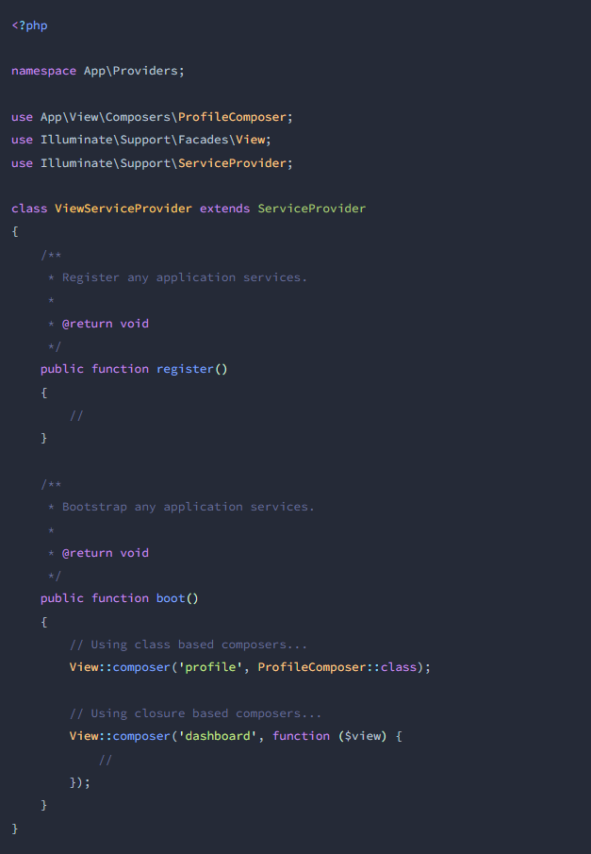
Views
View Composers
If you have data that you want to be bound to a view each time that view is rendered, a view composer can help you organize that logic into a single location.
Image Source: https://laravel.com/docs/9.x/views
Notes:
Left (White Color space):
Title - Parent Topic
Subtitle - Subtopic 1
Body Text - Description in bullets
Right (Grey Color Space):
Body Text - Relevant image (with source)/code snippet
Put reference links in Speaker Notes
Reference:
https://www.tutorialspoint.com/internet_technologies/internet_overview.htm/

Slide 8
Views
Control Structures
Blade provides convenient syntax for common PHP control structures.
Each of the control structures begins with @[structure] and ends with @[endstructure].
Image Source: https://laravel.com/docs/9.x/views
Notes:
Left (White Color space):
Title - Parent Topic
Subtitle - Subtopic 1
Body Text - Description in bullets
Right (Grey Color Space):
Body Text - Relevant image (with source)/code snippet
Put reference links in Speaker Notes
Reference:
https://www.tutorialspoint.com/internet_technologies/internet_overview.htm/

Slide 9
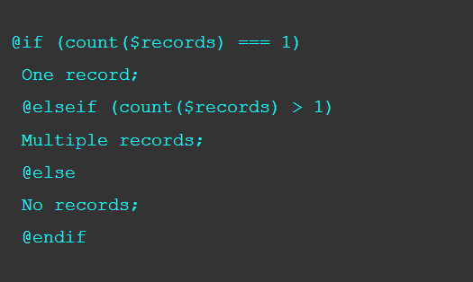
Views
If Statements
You may construct if statements using the @if, @elseif, @else, and @endif directives.
These directives function are identical to its PHP counterparts.
Image Source: https://laravel.com/docs/9.x/views
Notes:
Left (White Color space):
Title - Parent Topic
Subtitle - Subtopic 1
Body Text - Description in bullets
Right (Grey Color Space):
Body Text - Relevant image (with source)/code snippet
Put reference links in Speaker Notes
Reference:
https://www.tutorialspoint.com/internet_technologies/internet_overview.htm/

Slide 10
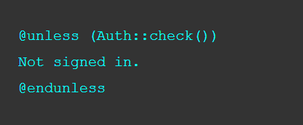
Views
If Statements
Blade also provides an @unless directive.
Image Source: https://laravel.com/docs/9.x/views
Notes:
Left (White Color space):
Title - Parent Topic
Subtitle - Subtopic 1
Body Text - Description in bullets
Right (Grey Color Space):
Body Text - Relevant image (with source)/code snippet
Put reference links in Speaker Notes
Reference:
https://www.tutorialspoint.com/internet_technologies/internet_overview.htm/

Slide 11
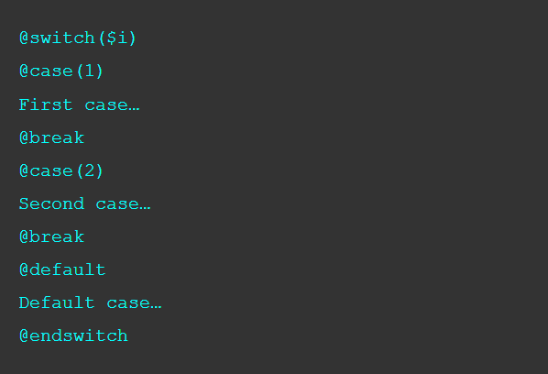
Views
Switch Statements
Switch statements are constructed by using the @switch, @case, @break, @default, and @endswitch directives.
Image Source: https://laravel.com/docs/9.x/views
Notes:
Left (White Color space):
Title - Parent Topic
Subtitle - Subtopic 1
Body Text - Description in bullets
Right (Grey Color Space):
Body Text - Relevant image (with source)/code snippet
Put reference links in Speaker Notes
Reference:
https://www.tutorialspoint.com/internet_technologies/internet_overview.htm/

Slide 12
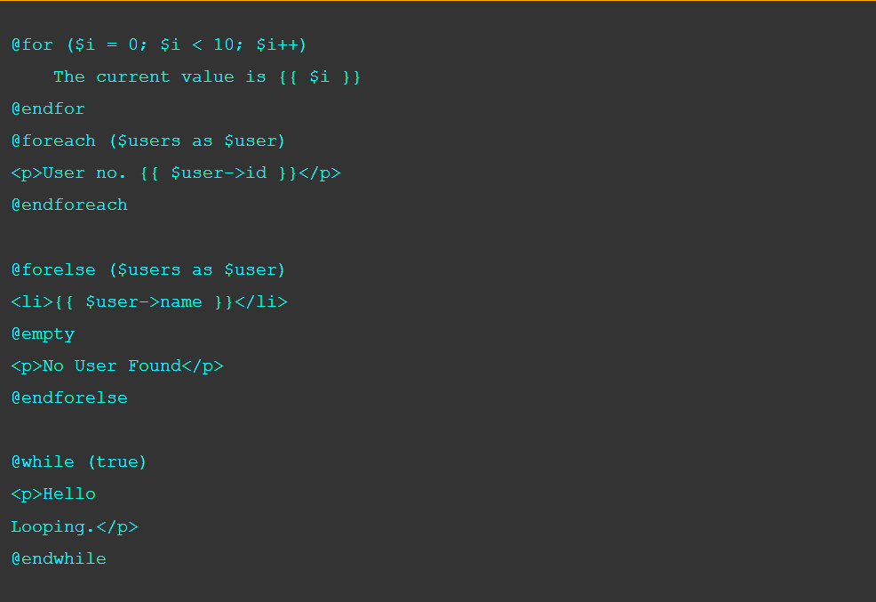
Views
Loops
Blade provides simple directives for working with PHP's loop: @for , @foreach , and @while.
They work the same in Blade as they do in PHP
Image Source: https://laravel.com/docs/9.x/views
Notes:
Left (White Color space):
Title - Parent Topic
Subtitle - Subtopic 1
Body Text - Description in bullets
Right (Grey Color Space):
Body Text - Relevant image (with source)/code snippet
Put reference links in Speaker Notes
Reference:
https://www.tutorialspoint.com/internet_technologies/internet_overview.htm/

Slide 13
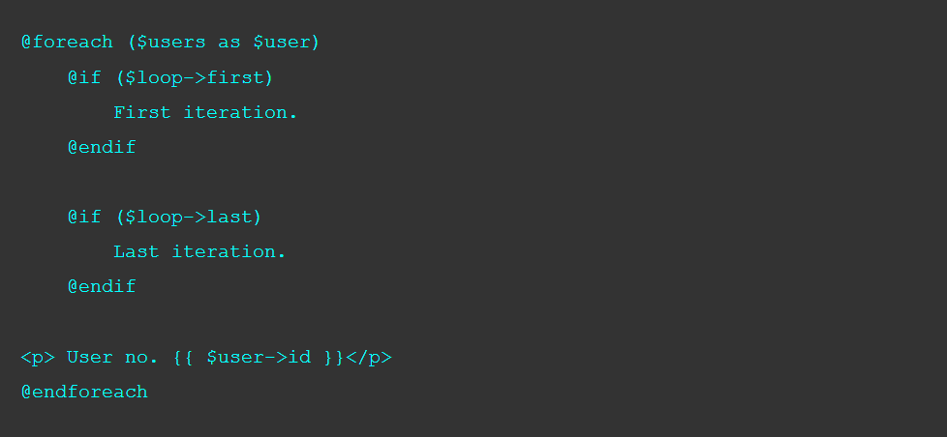
Views
Loop Variable
A $loop variable will be available inside our loop.
The variable provides access to useful bits of information like the current loop index, and whether it is the first or last iteration through the loop.
Image Source: https://laravel.com/docs/9.x/views
Notes:
Left (White Color space):
Title - Parent Topic
Subtitle - Subtopic 1
Body Text - Description in bullets
Right (Grey Color Space):
Body Text - Relevant image (with source)/code snippet
Put reference links in Speaker Notes
Reference:
https://www.tutorialspoint.com/internet_technologies/internet_overview.htm/

Slide 14
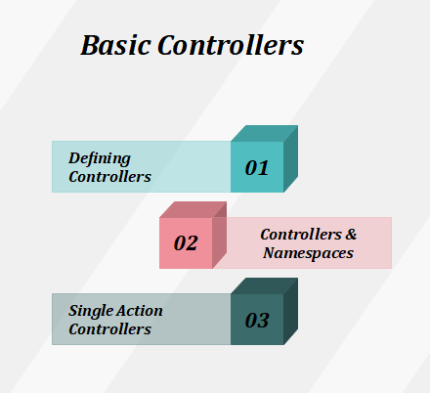
Controllers
Introduction
Controllers can group related request handling logic into a single class.
Controllers are stored in the app/Http/Controllers directory.
Image Source: https://laravel.com/docs/9.x/views
Notes:
Left (White Color space):
Title - Parent Topic
Subtitle - Subtopic 1
Body Text - Description in bullets
Right (Grey Color Space):
Body Text - Relevant image (with source)/code snippet
Put reference links in Speaker Notes
Reference:
https://www.tutorialspoint.com/internet_technologies/internet_overview.htm/

Slide 15
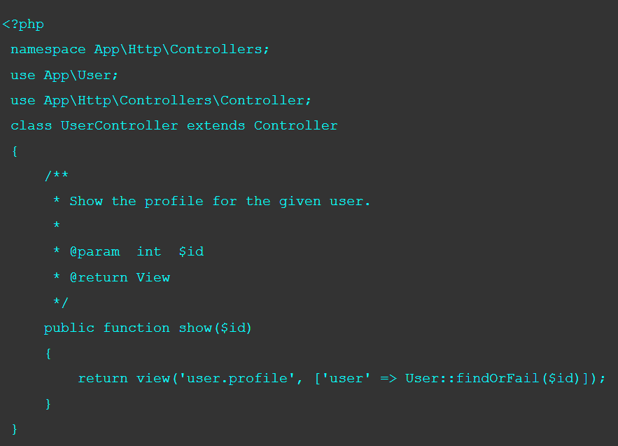

Controllers
Defining Controllers
The controllers extend the base controller class included with Laravel.
The base class provides a few uses to obtain methods such as the middleware method, which we used to attach the middleware to controller actions
Image Source: https://laravel.com/docs/9.x/views
Notes:
Left (White Color space):
Title - Parent Topic
Subtitle - Subtopic 1
Body Text - Description in bullets
Right (Grey Color Space):
Body Text - Relevant image (with source)/code snippet
Put reference links in Speaker Notes
Reference:
https://www.tutorialspoint.com/internet_technologies/internet_overview.htm/

Slide 16

Controllers
Controllers and Namespaces
The RouteServiceProvider loads our route files within a route group which contains the namespace, we can specify the portion of the class name that comes after the App\Http\Controllers portion of the namespace.
Image Source: https://laravel.com/docs/9.x/views
Notes:
Left (White Color space):
Title - Parent Topic
Subtitle - Subtopic 1
Body Text - Description in bullets
Right (Grey Color Space):
Body Text - Relevant image (with source)/code snippet
Put reference links in Speaker Notes
Reference:
https://www.tutorialspoint.com/internet_technologies/internet_overview.htm/

Slide 17
Controllers
Controllers and Namespaces
If we choose to divide our Controllers into the App\Http\Controllers directory, it uses the specific class name that is related to the App\Http\Controllers root namespace.
Image Source: https://laravel.com/docs/9.x/views
Notes:
Left (White Color space):
Title - Parent Topic
Subtitle - Subtopic 1
Body Text - Description in bullets
Right (Grey Color Space):
Body Text - Relevant image (with source)/code snippet
Put reference links in Speaker Notes
Reference:
https://www.tutorialspoint.com/internet_technologies/internet_overview.htm/

Slide 18
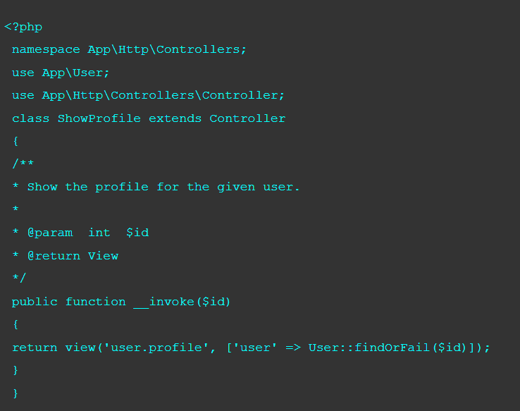
Controllers
Single Action Controllers
To define a controller that are only handles a single action, we place a single _invoke method on the controller.
When we are registering routes for a single action controllers, we do not need to specify a method.
Route::get('user/{id}', 'ShowProfile');
Image Source: https://laravel.com/docs/9.x/views
Notes:
Left (White Color space):
Title - Parent Topic
Subtitle - Subtopic 1
Body Text - Description in bullets
Right (Grey Color Space):
Body Text - Relevant image (with source)/code snippet
Put reference links in Speaker Notes
Reference:
https://www.tutorialspoint.com/internet_technologies/internet_overview.htm/

Slide 19

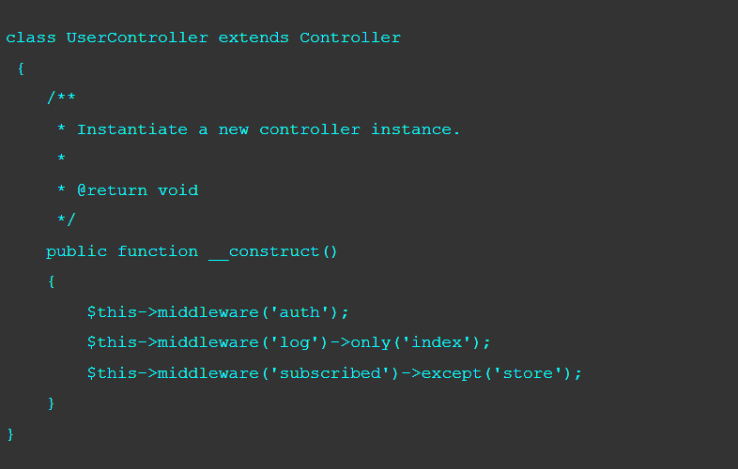
Controllers
Controller Middleware
Middleware can be assigned to the controller`s routes in our route files.
Using the middleware method from our controller`s constructor, we can easily assign middleware to the controller`s action.
Image Source: https://www.tutorialandexample.com/laravel-controller-middleware
Notes:
Left (White Color space):
Title - Parent Topic
Subtitle - Subtopic 1
Body Text - Description in bullets
Right (Grey Color Space):
Body Text - Relevant image (with source)/code snippet
Put reference links in Speaker Notes
Reference:
https://www.tutorialspoint.com/internet_technologies/internet_overview.htm/

Slide 20
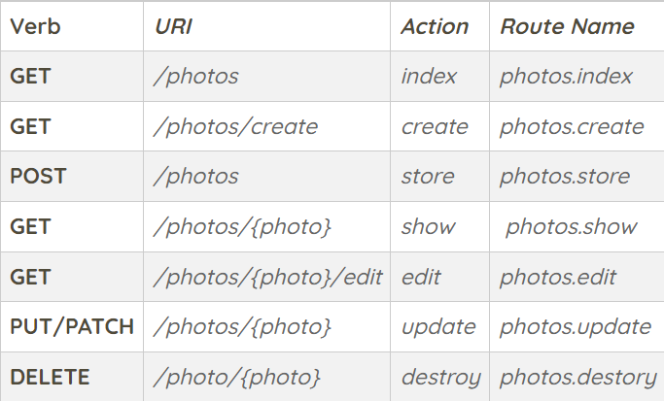
Controllers
Resource Controllers
Laravel resource routing assigns the “CRUD” routes to a controller with the help of single line code.
Create a controller that handles all HTTP requests “photos” stored by our application using the make:controller Artisan command. .
Php artisan make:controller PhotoController --resource
Image Source: https://www.tutorialandexample.com/laravel-controller-middleware
Notes:
Left (White Color space):
Title - Parent Topic
Subtitle - Subtopic 1
Body Text - Description in bullets
Right (Grey Color Space):
Body Text - Relevant image (with source)/code snippet
Put reference links in Speaker Notes
Reference:
https://www.tutorialspoint.com/internet_technologies/internet_overview.htm/

Slide 21
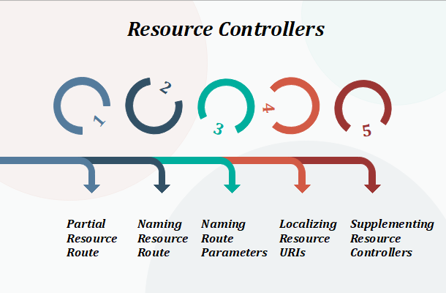
Controllers
Resource Controllers
The Resource Controllers are divided into 5 different types:
Partial Resource Route
Naming Resource Route
Naming Route Parameters
Localizing Resource URIs
Supplementing Resource Controllers
Image Source: https://www.tutorialandexample.com/laravel-controller-middleware
Notes:
Left (White Color space):
Title - Parent Topic
Subtitle - Subtopic 1
Body Text - Description in bullets
Right (Grey Color Space):
Body Text - Relevant image (with source)/code snippet
Put reference links in Speaker Notes
Reference:
https://www.tutorialspoint.com/internet_technologies/internet_overview.htm/

Slide 22
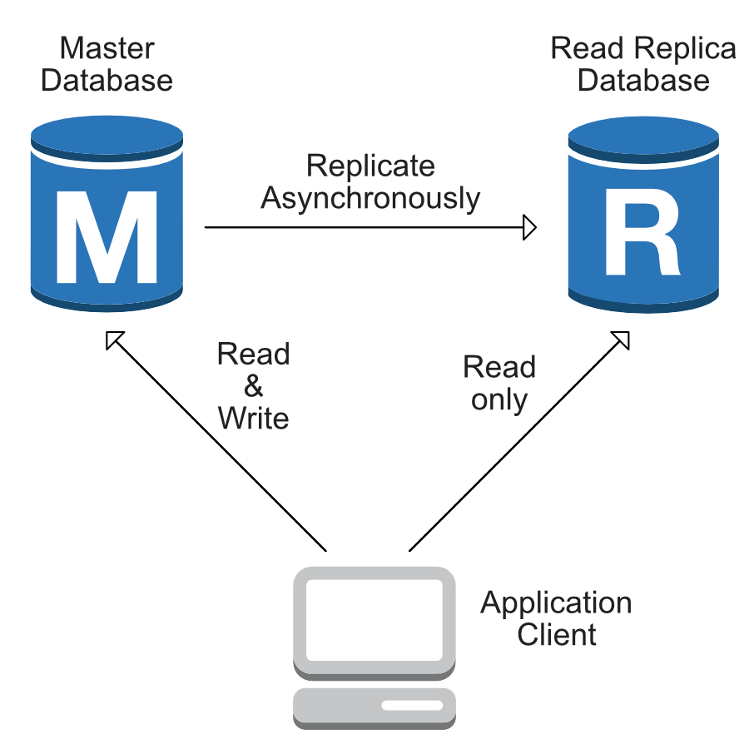
Complete database connectivity with DB
Introduction
Laravel makes interacting with databases extremely simple across a variety of database backends using either raw SQL, the fluent query builder, and the Eloquent ORM.
Laravel supports four databases:
- MySQL - Postgres - SQLite - SQL Server
Image Source: https://laravel.com/docs/5.2/database
Notes:
Left (White Color space):
Title - Parent Topic
Subtitle - Subtopic 1
Body Text - Description in bullets
Right (Grey Color Space):
Body Text - Relevant image (with source)/code snippet
Put reference links in Speaker Notes
Reference:
https://www.tutorialspoint.com/internet_technologies/internet_overview.htm/

Slide 23
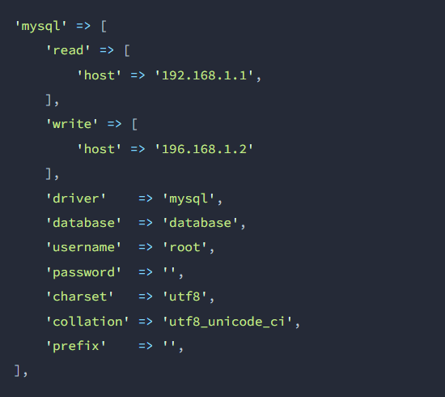
Complete database connectivity with DB
Read & Write Connections
To use one database connection for SELECT statements, and another for INSERT, UPDATE, and DELETE statements.
Laravel makes this a breeze, and the proper connections will always be used whether you are using raw queries, the query builder, or the Eloquent ORM.
Image Source: https://laravel.com/docs/5.2/database
Notes:
Left (White Color space):
Title - Parent Topic
Subtitle - Subtopic 1
Body Text - Description in bullets
Right (Grey Color Space):
Body Text - Relevant image (with source)/code snippet
Put reference links in Speaker Notes
Reference:
https://www.tutorialspoint.com/internet_technologies/internet_overview.htm/

Slide 24
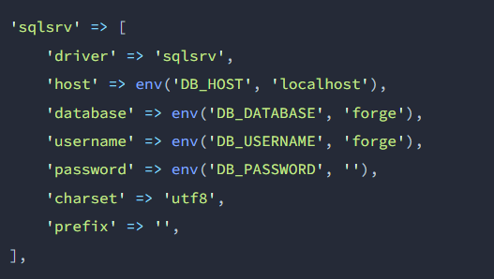
Complete database connectivity with DB
SQL Server Configuration
To add the connection configuration for the database
Image Source: https://laravel.com/docs/5.2/database
Notes:
Left (White Color space):
Title - Parent Topic
Subtitle - Subtopic 1
Body Text - Description in bullets
Right (Grey Color Space):
Body Text - Relevant image (with source)/code snippet
Put reference links in Speaker Notes
Reference:
https://www.tutorialspoint.com/internet_technologies/internet_overview.htm/

Slide 25
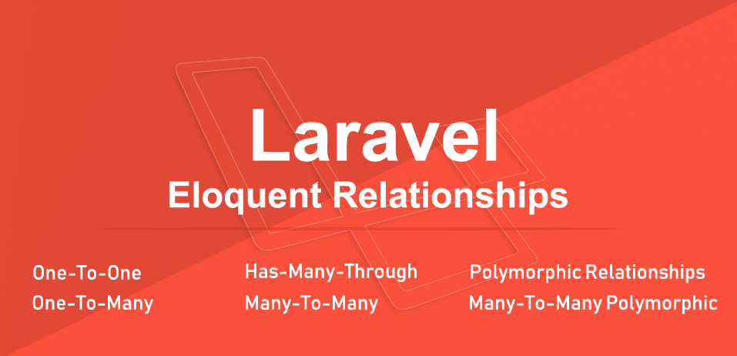
Complete Database connectivity with Eloquent
Eloquent Relationships Laravel
Eloquent relationships are specified as a method on our Eloquent model classes.
Eloquent models relationships also serve as powerful query builders, defining relationships as a method, provides powerful method chaining and query capabilities.
Image Source: https://www.coderomeos.org/laravel-eloquent-relationships
Notes:
Left (White Color space):
Title - Parent Topic
Subtitle - Subtopic 1
Body Text - Description in bullets
Right (Grey Color Space):
Body Text - Relevant image (with source)/code snippet
Put reference links in Speaker Notes
Reference:
https://www.tutorialspoint.com/internet_technologies/internet_overview.htm/

Slide 26
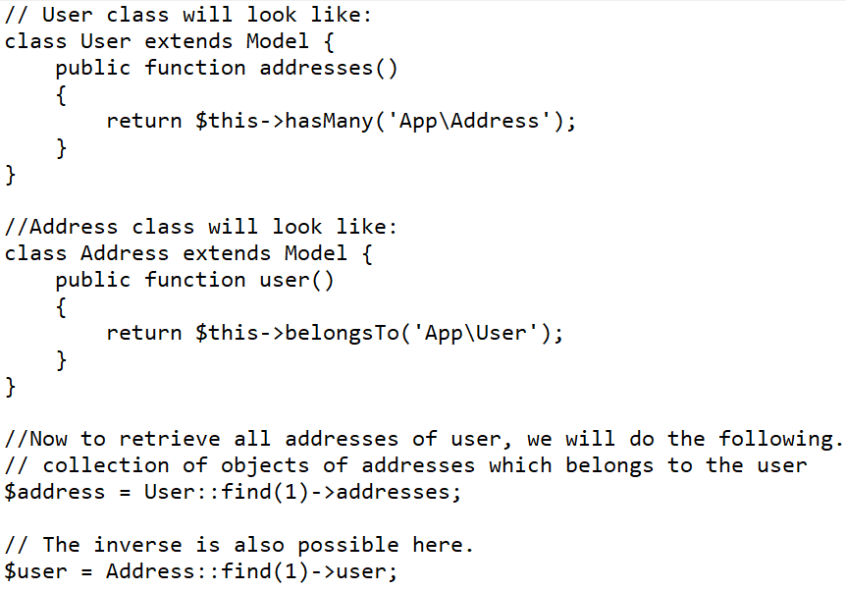
Complete Database connectivity with Eloquent
One to one Relationship
One-to-many relationship can be thinking of a user having multiple addresses.
A user can have one or more address and an address will only belong to a single user.
Laravel gives this functionality by using hasMany() method.
Image Source: https://www.coderomeos.org/laravel-eloquent-relationships
Notes:
Left (White Color space):
Title - Parent Topic
Subtitle - Subtopic 1
Body Text - Description in bullets
Right (Grey Color Space):
Body Text - Relevant image (with source)/code snippet
Put reference links in Speaker Notes
Reference:
https://www.tutorialspoint.com/internet_technologies/internet_overview.htm/

Slide 27
Complete Database connectivity with Eloquent
One to Many Relationship
One-to-many relationship can be thinking of a user having multiple addresses.
A user can have one or more address and an address will only belong to a single user.
Laravel gives this functionality by using hasMany() method.
Image Source: https://www.coderomeos.org/laravel-eloquent-relationships
Notes:
Left (White Color space):
Title - Parent Topic
Subtitle - Subtopic 1
Body Text - Description in bullets
Right (Grey Color Space):
Body Text - Relevant image (with source)/code snippet
Put reference links in Speaker Notes
Reference:
https://www.tutorialspoint.com/internet_technologies/internet_overview.htm/

Slide 28
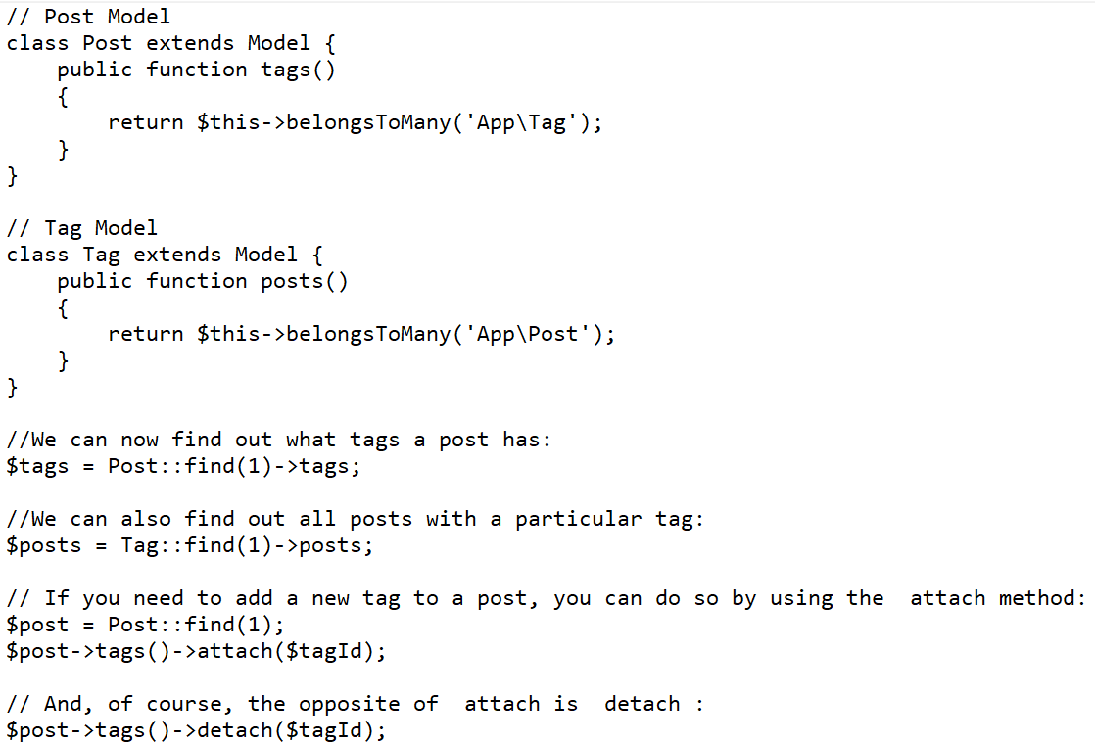
Complete Database connectivity with Eloquent
Many-to-many Relationship
Many to many relationships is more complicated to the above two relationships.
Instead of two tables, a third table is involved as pivot table which will hold the information of the relationship.
Both the models, Post and Tag will be using the “belongsToMany()” methods.
Image Source: https://www.coderomeos.org/laravel-eloquent-relationships
Notes:
Left (White Color space):
Title - Parent Topic
Subtitle - Subtopic 1
Body Text - Description in bullets
Right (Grey Color Space):
Body Text - Relevant image (with source)/code snippet
Put reference links in Speaker Notes
Reference:
https://www.tutorialspoint.com/internet_technologies/internet_overview.htm/

Slide 29
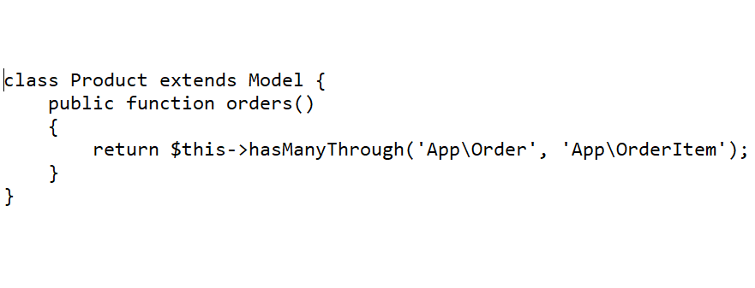
Complete Database connectivity with Eloquent
Has-many-through Relationship
The 'has many through' relationship provides a convenient way of accessing the distant or intermediate relations.
The first parameter in the hasManyThrough method is the target model, and the second parameter is the intermediate model we go through to get to it.
Image Source: https://www.coderomeos.org/laravel-eloquent-relationships
Notes:
Left (White Color space):
Title - Parent Topic
Subtitle - Subtopic 1
Body Text - Description in bullets
Right (Grey Color Space):
Body Text - Relevant image (with source)/code snippet
Put reference links in Speaker Notes
Reference:
https://www.tutorialspoint.com/internet_technologies/internet_overview.htm/

Slide 30
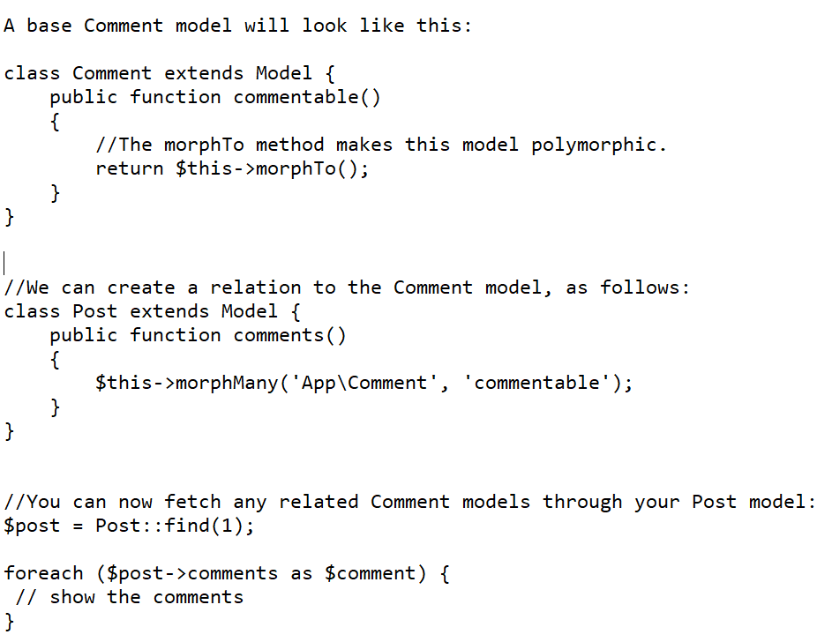
Complete Database connectivity with Eloquent
Polymorphic relationship
The Polymorphic relationship is similar to the one-to-many relationship.
When a single model belongs to more than one type of model on a single association is known as one-to-one polymorphic relationship.
Image Source: https://www.coderomeos.org/laravel-eloquent-relationships
Notes:
Left (White Color space):
Title - Parent Topic
Subtitle - Subtopic 1
Body Text - Description in bullets
Right (Grey Color Space):
Body Text - Relevant image (with source)/code snippet
Put reference links in Speaker Notes
Reference:
https://www.tutorialspoint.com/internet_technologies/internet_overview.htm/

Slide 31
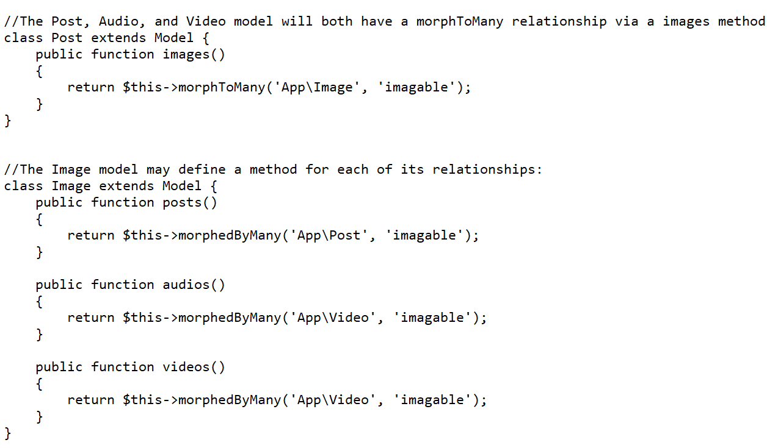
Complete Database connectivity with Eloquent
Many-to-many polymorphic relationship
A target model consists of unique records that are shared among the various models.
Image Source: https://www.coderomeos.org/laravel-eloquent-relationships
Notes:
Left (White Color space):
Title - Parent Topic
Subtitle - Subtopic 1
Body Text - Description in bullets
Right (Grey Color Space):
Body Text - Relevant image (with source)/code snippet
Put reference links in Speaker Notes
Reference:
https://www.tutorialspoint.com/internet_technologies/internet_overview.htm/

